Slide 1
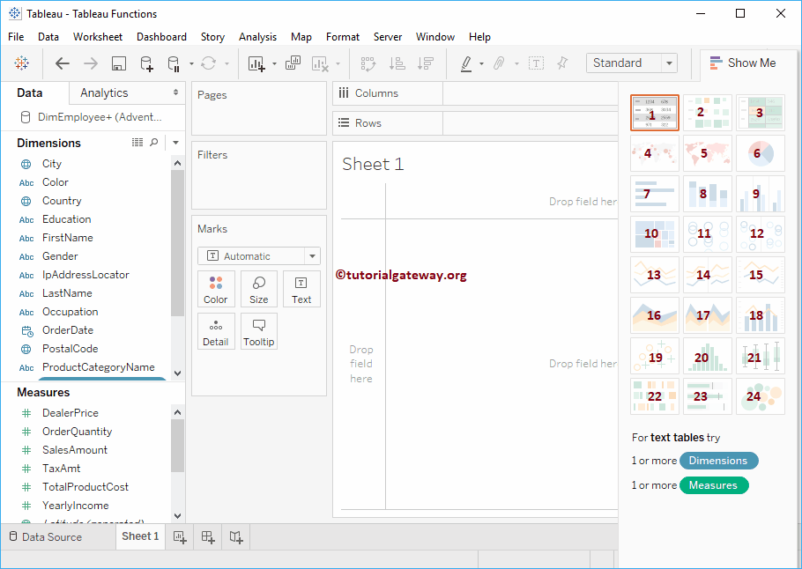
List of Tableau Charts
Notes:
Text Label: Use this Text label chart to create Pivot data (also called as Crosstabs)
Heat Map: This is used to display the data along with colours.
Highlight Table: This type of report will help you to compare the categorical data using colours.
Symbol Maps: Visualize the geographical data using bubbles/symbols.
Maps: Visualize the geographical data.
Pie Chart: It is very useful to display the High-level data. For example, Sales by Country, Region etc.
Horizontal Bars: This chart is very useful for comparisons. For example, you can use this chart compares the Sales in this year vs previous years etc.
Stacked Bars: This chart is helpful to further divide the Horizontal Bars
Side-By-Side Bars: Also called as Grouped Bar Chart. Use this to visually compare data side by side.
Treemap: Use this to display the data in Rectangle Boxes.
Circle Views: It displays the numeric data in circles.
Side-By-Side Circle Views: Display Circles for multiple measures
Line Chart: Use this Line chart to display Trends. For example, temp at a continuous time period, Sales Trend etc.
Discrete Lines: Display the discrete lines
Dual Lines: Helps to compare trends-- of multiple measures.
Area Chart: This is used to graphically represent the quantitative data.
Discrete Area Chart: Use this to create a discrete area chart for quantitative data.
Dual Combination Chart: Helps you to compare one Measure against Other measures.
Scatter Plot: The scatter plot in the tableau is useful to visualize the relationship between any two sets of data
Histograms: Visualize the statistical information in user-specified range.
Box and Whisker Plots: Use this Box and whisker plot to graphically visualizing numeric data by grouping specific data.
Gantt Chart: To visualize the duration of an event or activity.
Bullet Graph: Use this chart for displaying three-dimensional data.
Packed Bubbles Chart: This chart will display the data in bubbles

Slide 2
Charts are most effective and readable when matched to the right data and purpose.

Slide 3
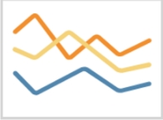
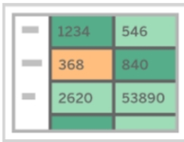
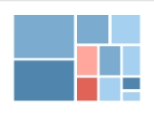
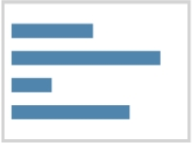
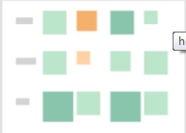
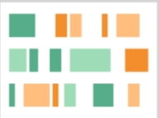
Highlight Table — Shows detailed information on heat maps.
Examples: The percent of a market for different segments, or sales numbers in a region.
Line — View trends in data over time.
Examples: Stock price change over a five-year period or website page views during a month.
Bar — Compare data across categories.
Examples: Volume of shirts in different sizes, or percent of spending by department.
Treemap — Show hierarchical data as a proportion of a whole.
Examples: Storage usage across computer machines, comparing fiscal
Heat Map — Show the relationship between two factors.
Examples: Segment analysis of target market, or sales leads by individual rep.
Gantt — Show duration over time.
Examples: Project timeline, duration of a machine’s use, availability of players on a team.

Slide 4
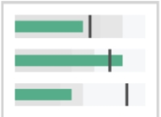
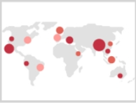

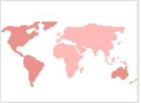
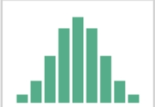
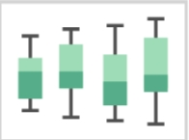
Bullet — Evaluate performance of a metric against a goal.
Examples: Sales quota assessment, performance spectrum (great/good/poor).
Symbol maps — Use for totals rather than rates. Be careful, as small differences will be hard to see.
Examples: Number of customers in different geographies.
Scatterplot — Investigate relationships between quantitative values.
Examples: Male versus female likelihood of having lung cancer at different ages, or technology early adopters’ and laggards’ purchase patterns of smart phones.
Area maps — Use for rates rather than totals. Use sensible base geography. Examples: Rates of internet-usage in certain geographies, house prices in different neighborhoods.
Histogram — Understand the distribution of your data.
Examples: Number of customers by company size, student performance on an exam, frequency of a product defect.
Box-and-Whisker — Show the distribution of a set of a data.
Examples: Understanding your data at a glance, seeing how data is skewed towards one end, identifying outliers in your data.

Slide 5
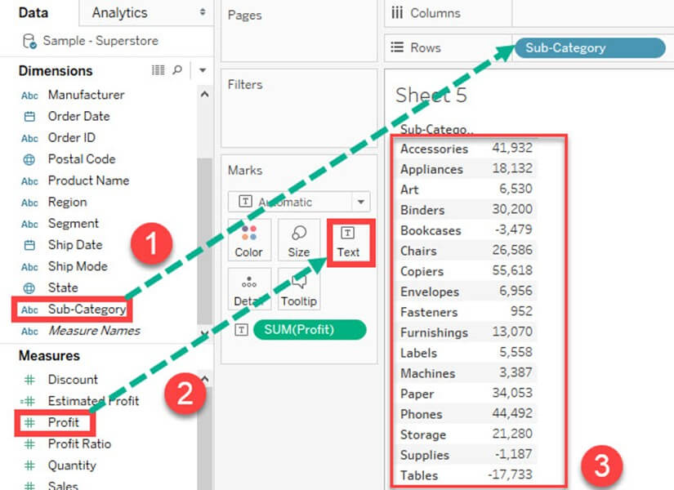
Text Tables
Notes:
Text tables are used to show the exact value of measures across the different dimension. A text table is also called as a Pivot Table. It groups the dimensions and measures by default. The procedure to design a text table is given as follows.
Step) Go to a new Worksheet.
Drag 'Sub-Category' into Rows.
Drag 'Profit' into text box present in the marks card.
It creates a text table by default.

Slide 6
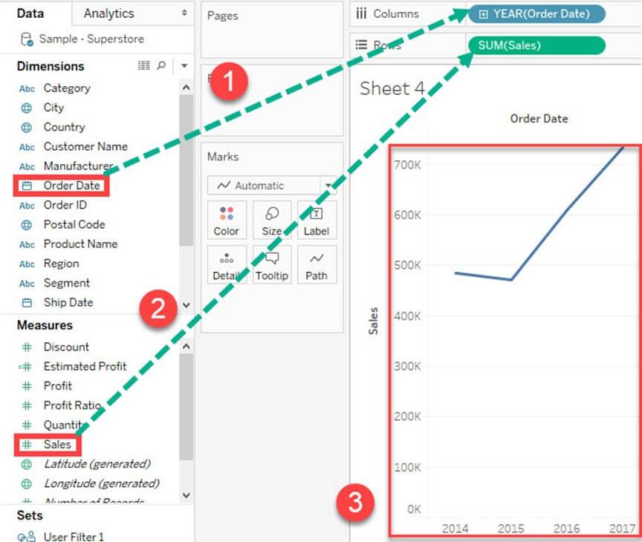
Line chart
Notes:
A Line Chart should be used to compare the data over the different periods. A line chart is created by the series of dots. These dots represent the measured value in each period. The procedure to create line graph is shown below.
Step) Go to a new Worksheet.
Drag 'Order Date' into Columns.
Drag 'Sales' into Rows.
It creates a line chart by default.

Slide 7
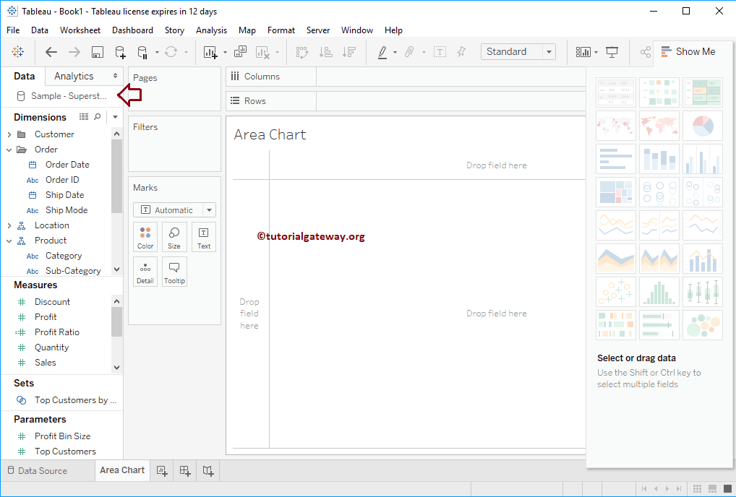
Area Chart
Notes:
Tableau Area Chart is a Line Chart where the Area between the Axis and the Lines are filled with colour (s). In this article, we will show you, How to Create Area Chart in Tableau with an example.
For this Tableau Area chart demonstration, we are going to use the Sample – Superstore Data Source.

Slide 8
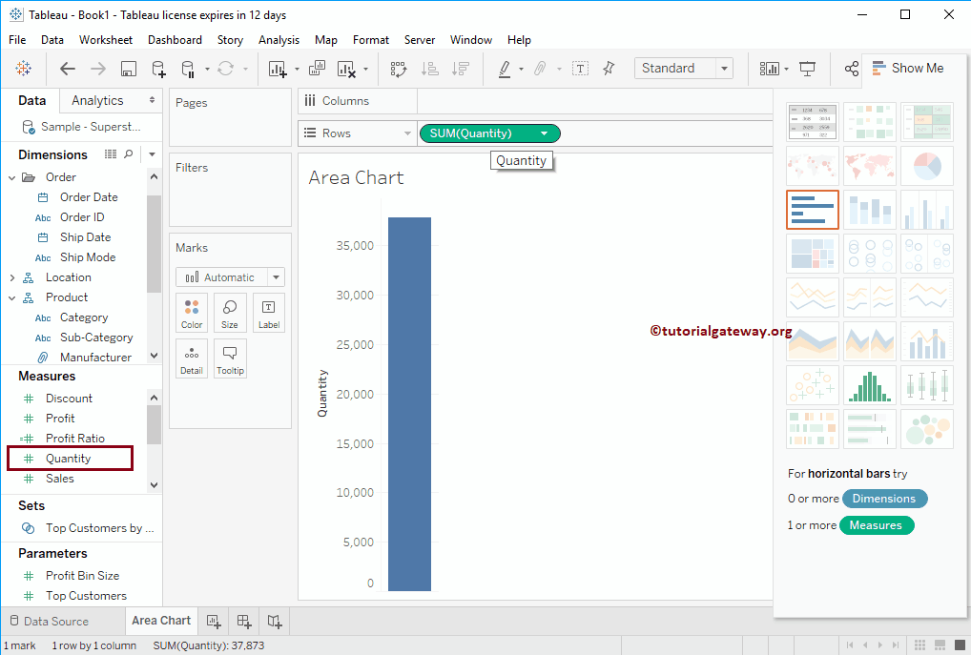
Notes:
Tableau Area Chart Example
In order to create a Tableau Area Chart First, Drag and Drop Quantity from Measures Region to Rows Shelf. Since it is a Measure value, Quantity will be aggregated to default Sum. Once you drag them, Bar Chart will be generated as we shown below.

Slide 9
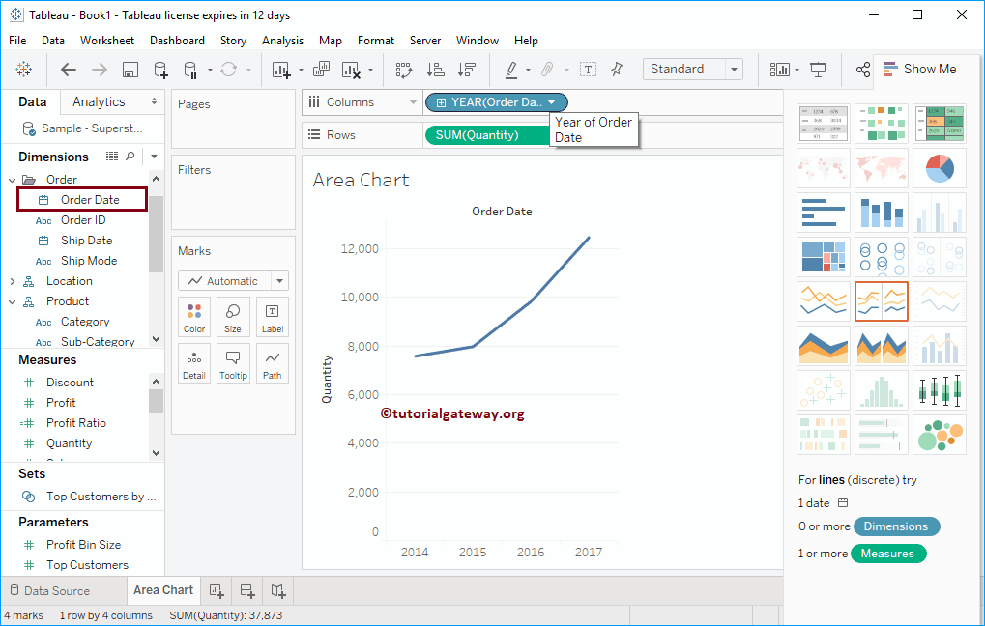
Notes:
Next, Drag and Drop Year from Dimension Region to Column Shelf. Once you drag them, Line Chart will be generated as we shown above.

Slide 10
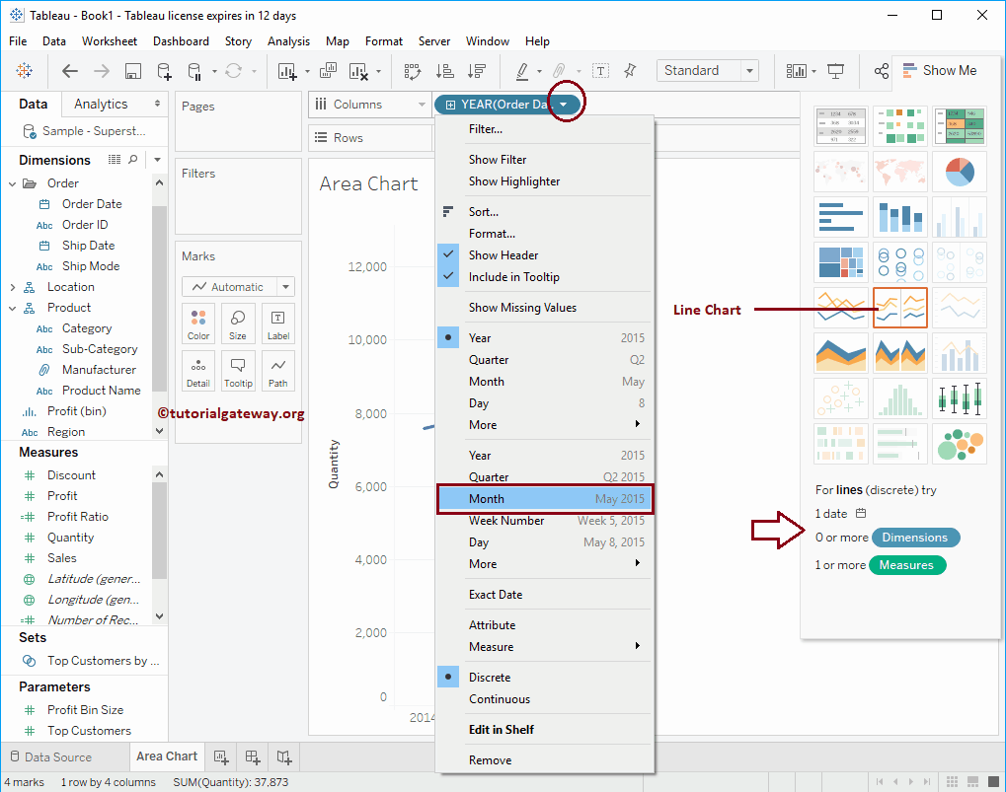
Notes:
Let us change the value from Year to All months present in each year to see the detailed monthly information (trend)

Slide 11
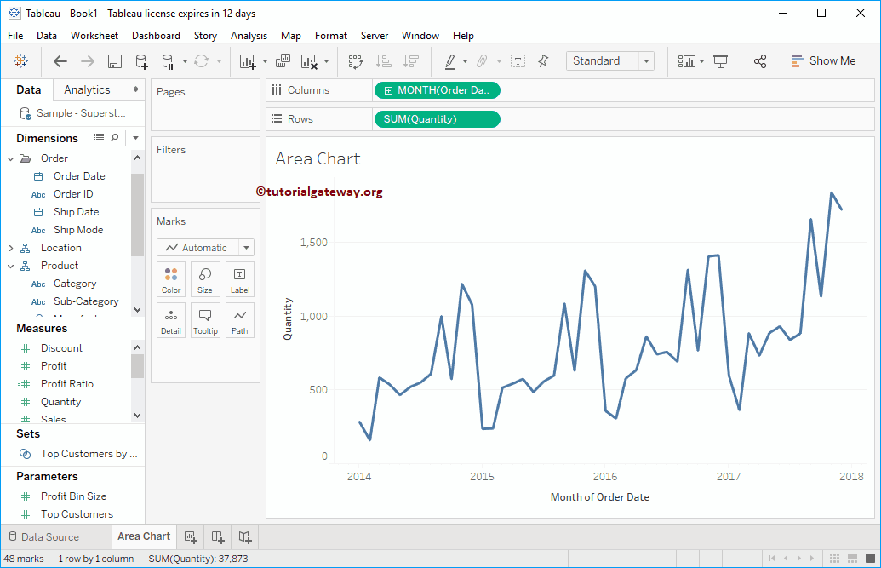
Notes:
Now you can see the detailed Line chart for each month present in 2014, 2015, 2016, 2017, and 2018

Slide 12
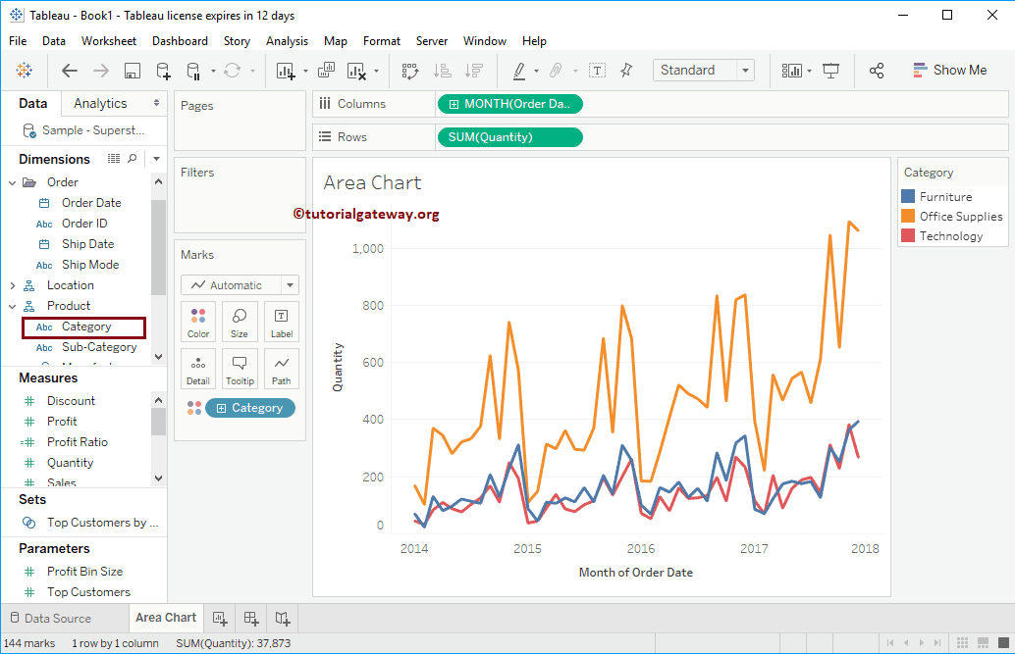
Notes:
Let me compare the Trend for each Category. To do so, Drag and Drop the Category from Dimension Region to the Colors field present in the Marks Shelf.

Slide 13
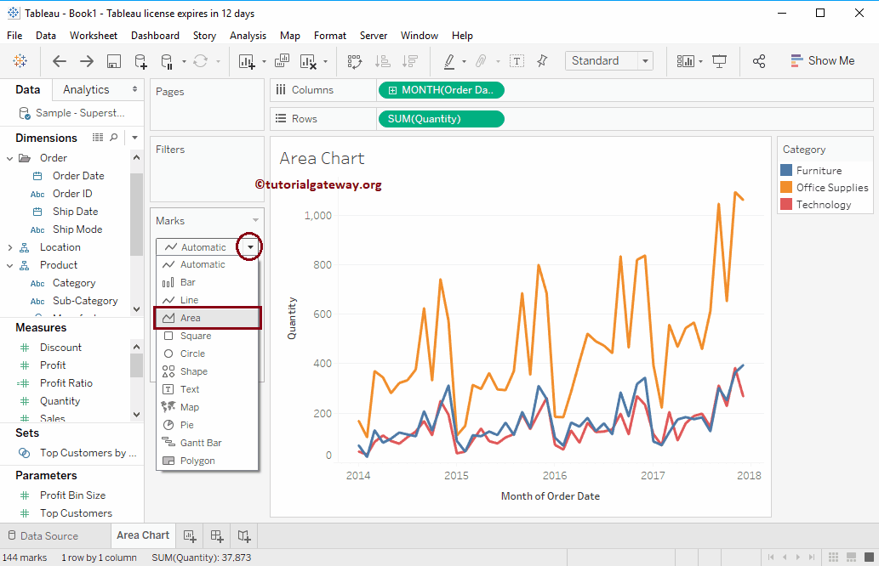
Notes:
Now you can see the Trend for each and every category. In order to convert the Line chart to Area Chart, Please change the Mark type from Automatic to Area Chart as we shown below. Or, Select Area Chart from the Show Me window.

Slide 14
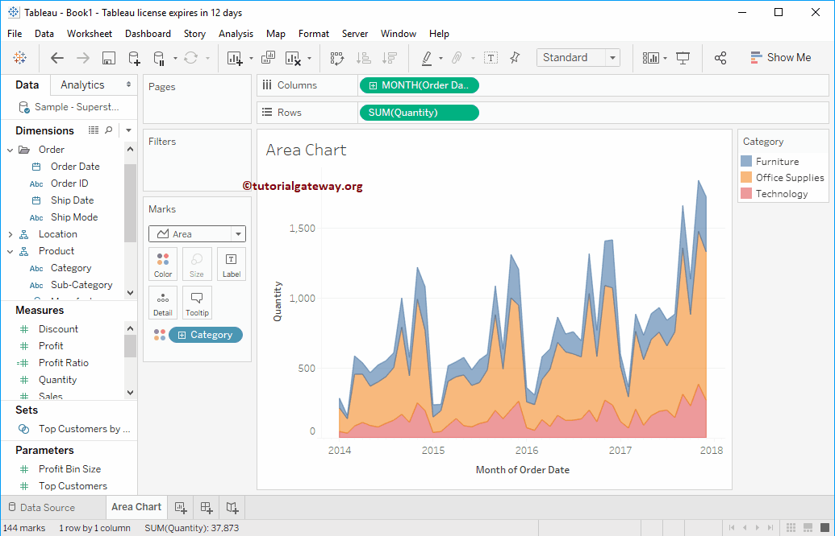
Notes:
Now you can see the Area Chart

Slide 15
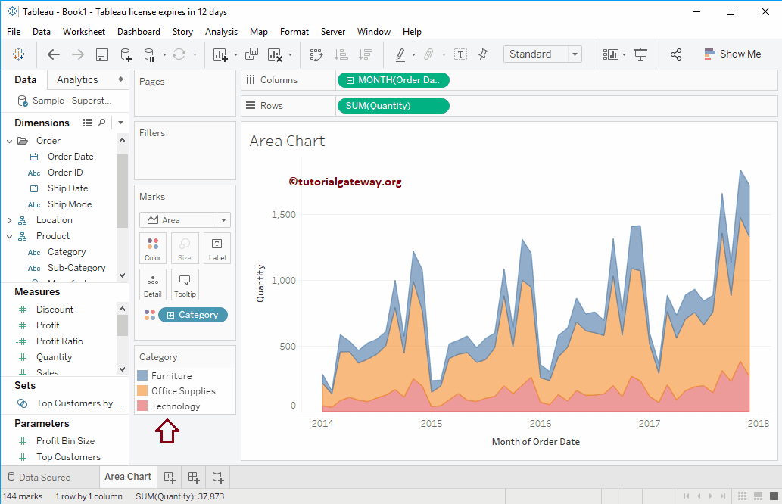
Notes:
Let me change the Categories position

Slide 16
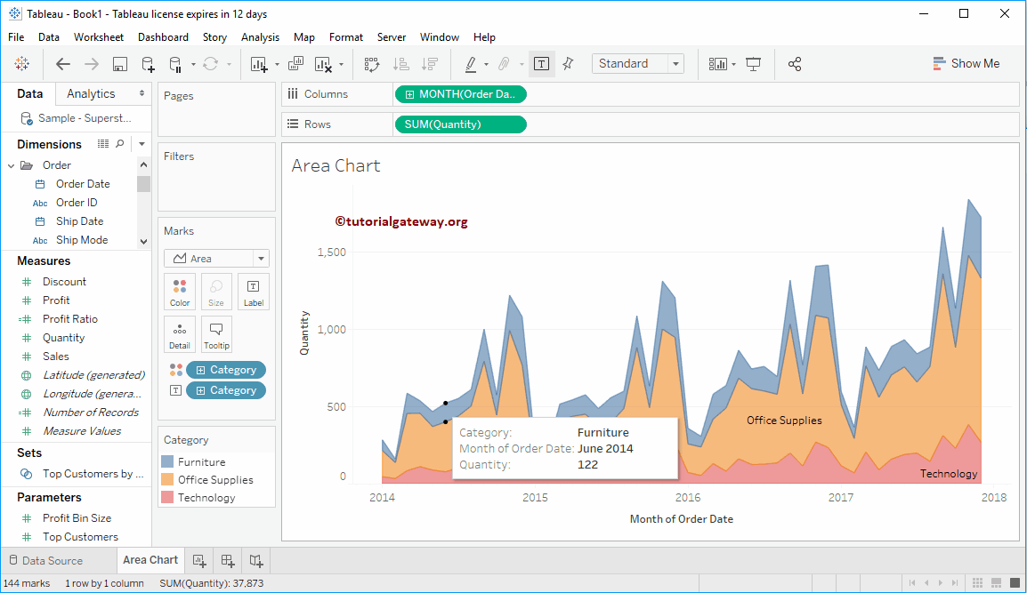
Notes:
Add Labels to Tableau Area Chart
Drag and Drop the Category from Dimension Region to the Text or Label field present in the Marks Shelf. From the below screenshot you can see the categories Names on Area Chart.

Slide 17
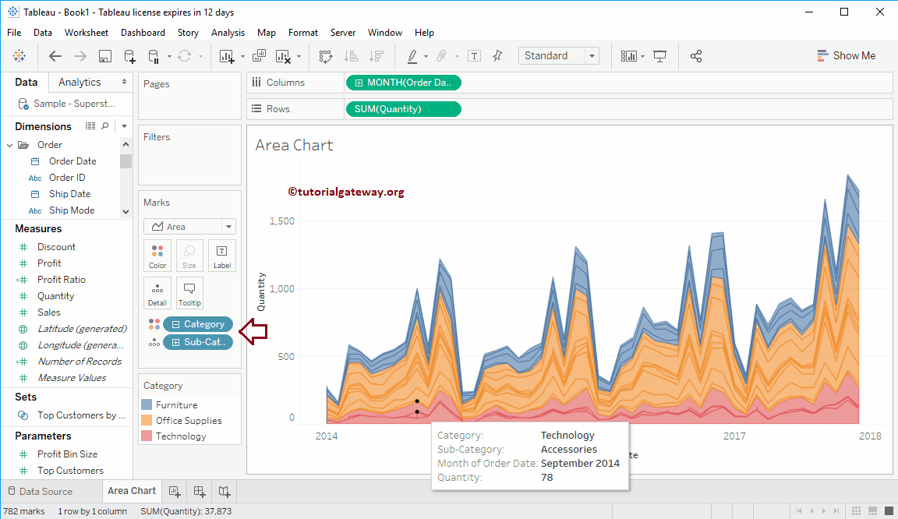
Notes:
Detailed Tableau Area Chart
Let me expand the Category to show the Area Chart for each and every Sub-category

Slide 18
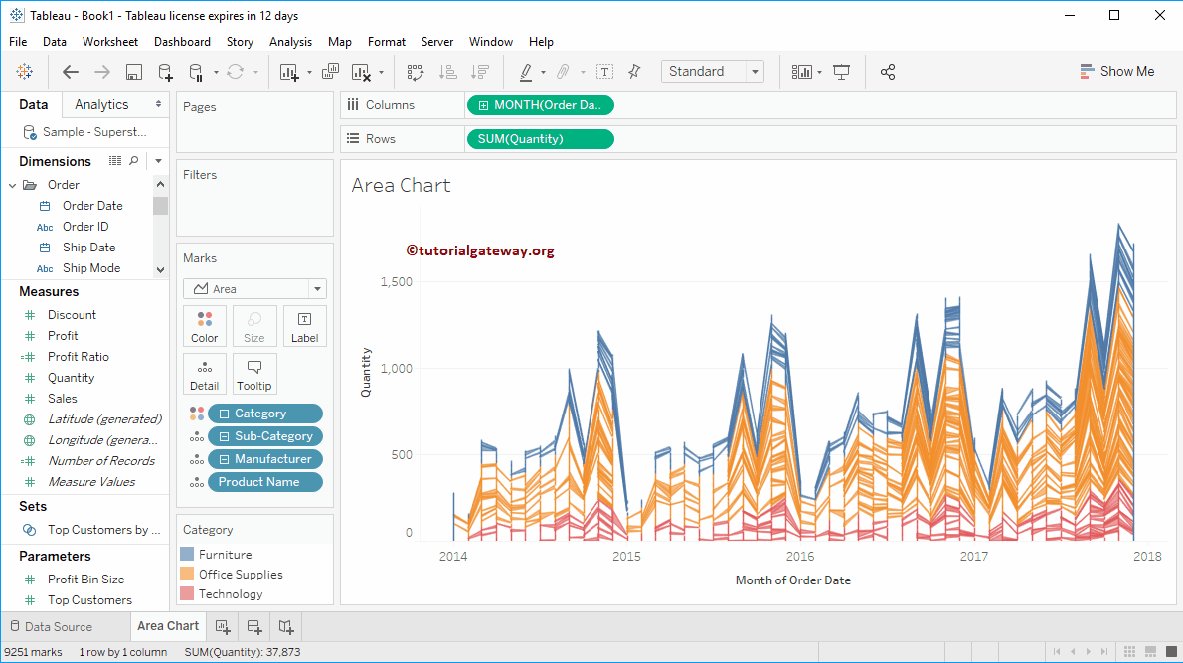
Notes:
From the below screenshot you can see, we further divided the Area chart based on the Product Name

Slide 19
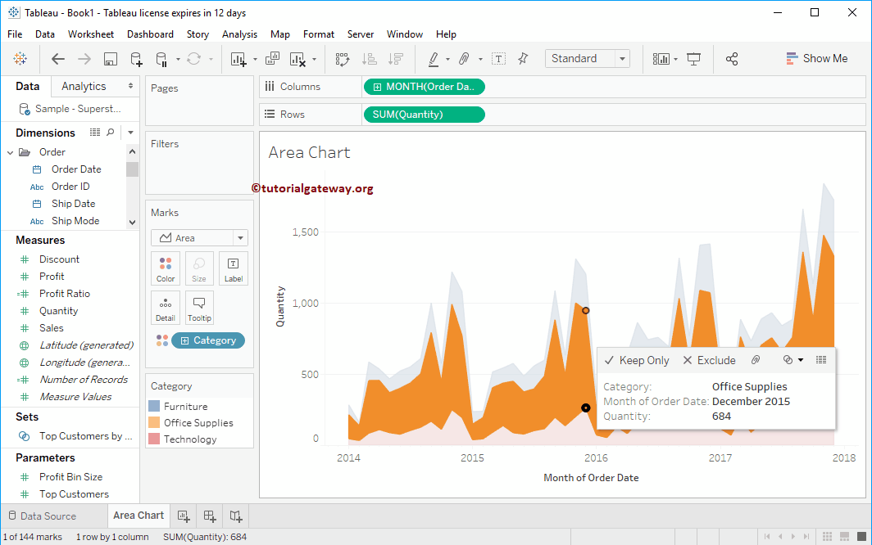
Notes:
Selecting any specific area will show you the information at that particular point.

Slide 20
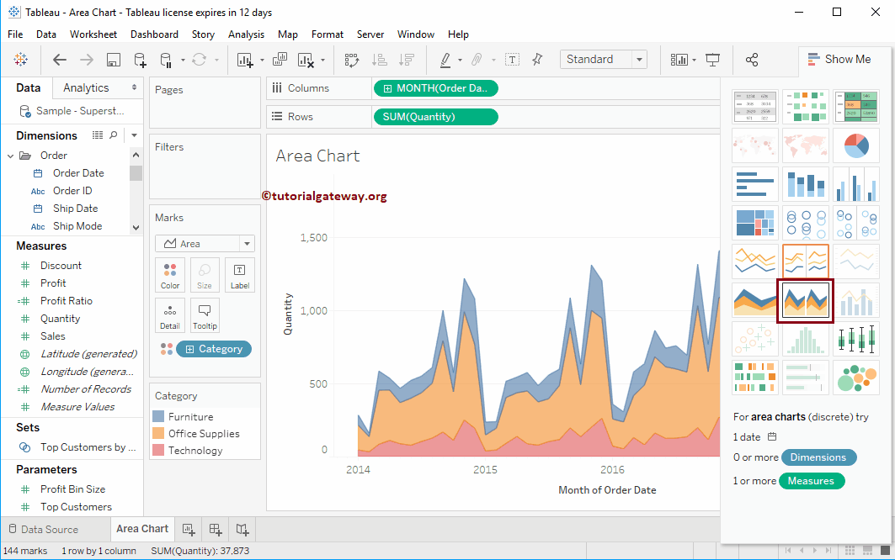
Notes:
Discrete Area Chart in Tableau
Tableau has one more option called Discrete Area Chart. Let me select the same from Show Me

Slide 21
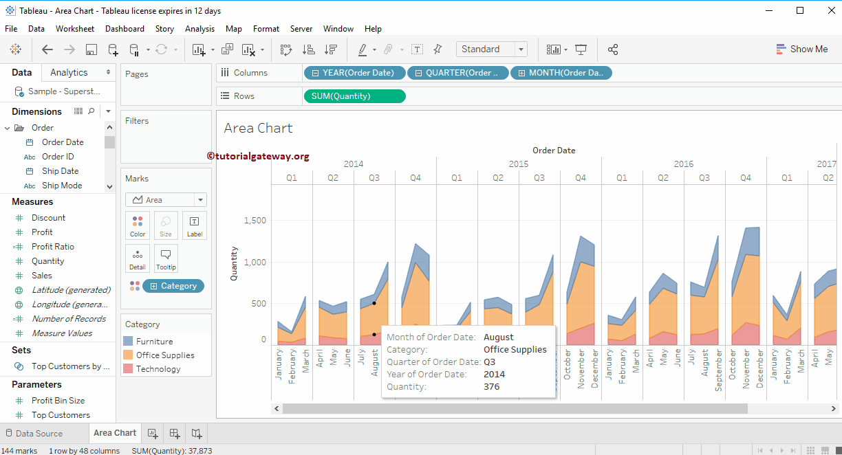
Notes:
Now you can see the Discrete Area Chart in Tableau for each category

Slide 22
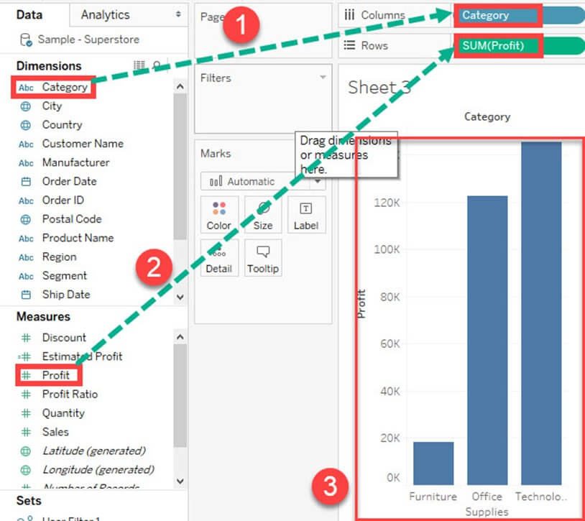
Bar Chart
Notes:
A bar chart can compare the data across different categories. The height of the bars represents the measured value of each category. It can be represented as vertical and horizontal type bar charts. The procedure to create bar chart is given as follows.
Step) Go to a new worksheet.
Drag 'Category' into Column.
Drag 'Profit' into Rows.
It creates a bar chart by default.

Slide 23
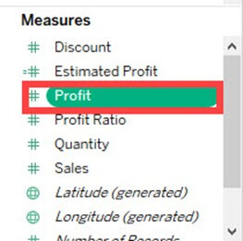
Histogram
Notes:
Histogram:
A histogram can show the values present in a measure and its frequency. It shows the distribution of numerical data. As it shows both frequency and measure value by default, it can be useful in many cases. For example, if you want to analyze the discount given by a retail shop, you can visualize the amount of discount and its frequency using histogram. The procedure to create histogram is shown below.
Step 1) Go to a new Worksheet.
Select 'Discount' from the measures.

Slide 24
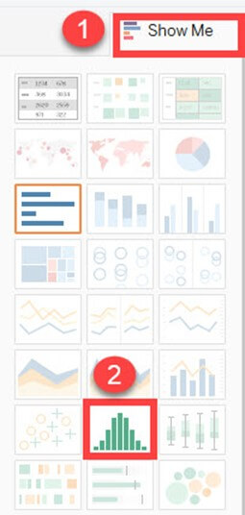
Notes:
Step 2)
Click on 'Show Me' button present in the top right corner of the worksheet.
Select the 'Histogram' icon as shown in the image.

Slide 25
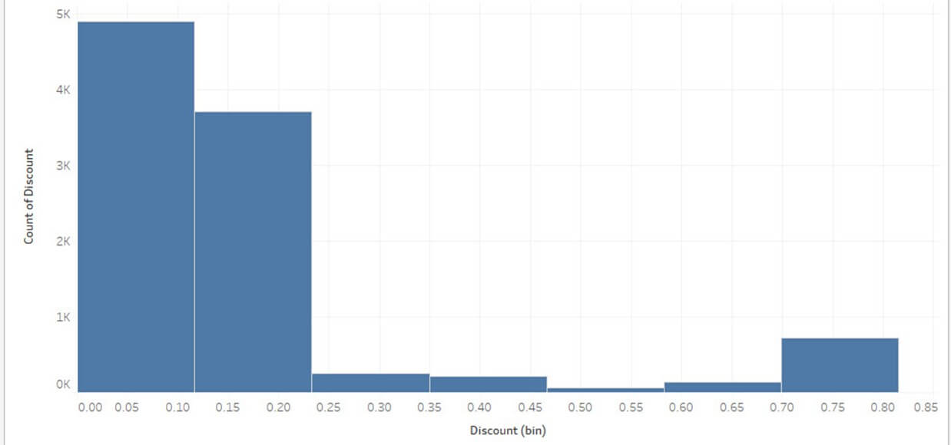
Notes:
It creates a histogram chart in Tableau.

Slide 26
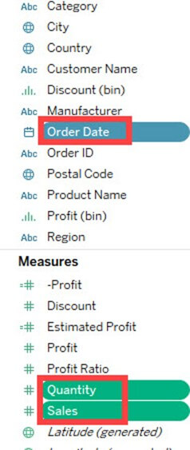
Notes:
Dual Axis Chart:
Dual axis chart can be used to visualize two different measures in two different chart types. A date column and two measures are necessary to build a dual axis chart. The different scales used in the graph helps the user to understand both measures. The procedure to create dual axis chart is shown below.
Step 1) Go to a new Worksheet.
Hold the control key and select 'Order Date', 'Sales' and 'Quantity'.

Slide 27
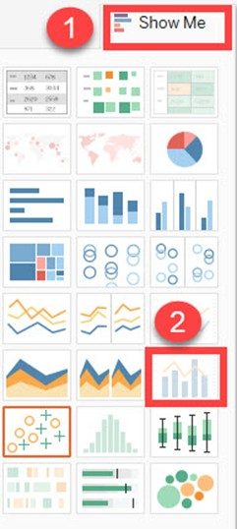
Notes:
Step 2)
Click on 'Show Me' option present in the top right corner of Worksheet.
Select 'dual combination' icon as shown in the image.

Slide 28
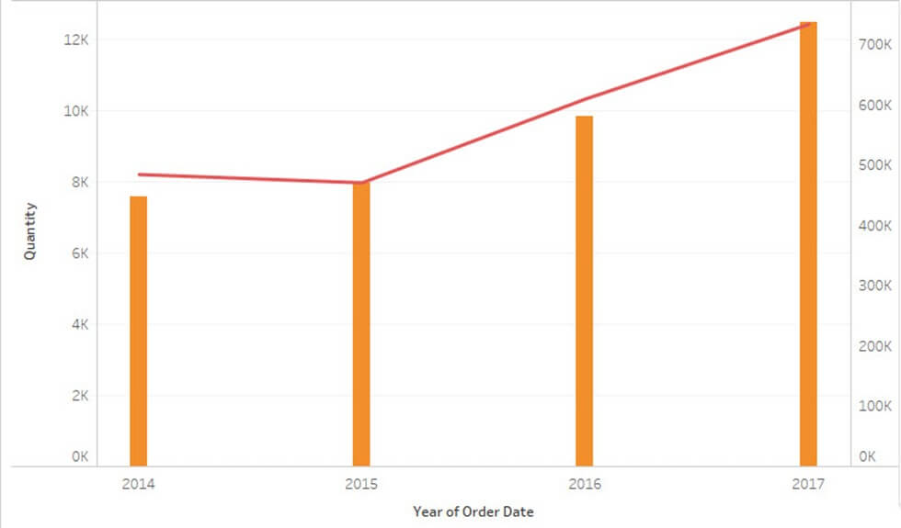
Notes:
It creates a dual axis chart as shown in the figure.

Slide 29
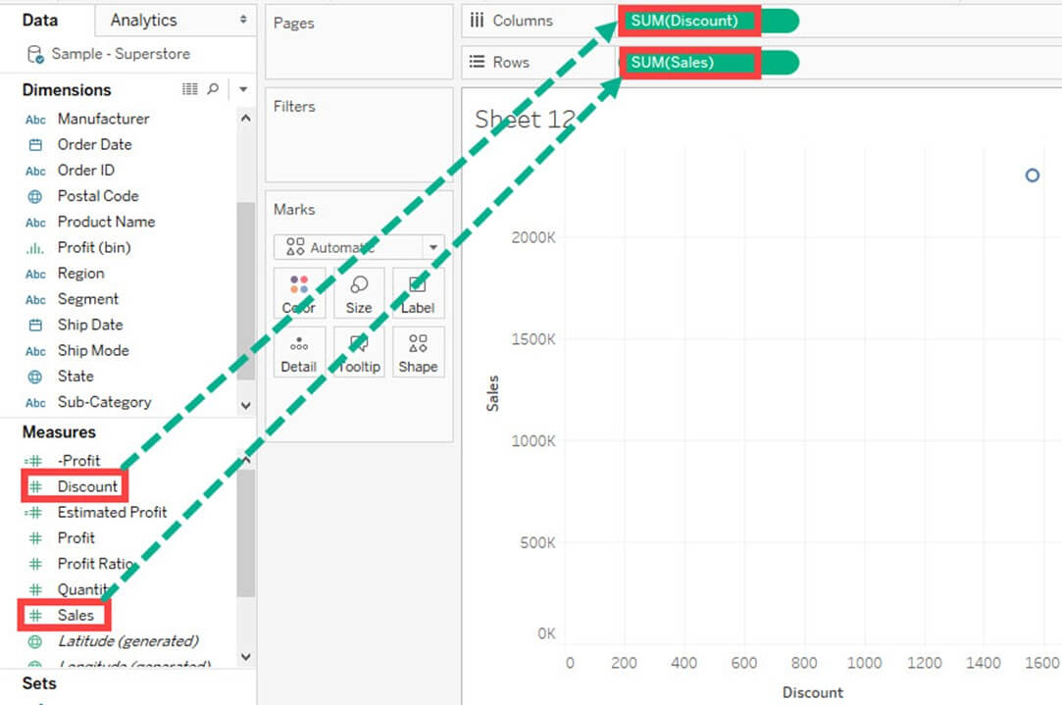
Scatter Plot
Notes:
Scatter Plot:
The relationship between two measures can be visualized using scatter plot. A scatter plot is designed by adding measures in both x and y-axis. This can show the trend or relationship between the measures selected. A scatter plot can be designed by following the below procedure.
Step 1) Go to a new Worksheet.
Drag 'Discount' into Columns.
Drag 'Sales' into Rows.

Slide 30
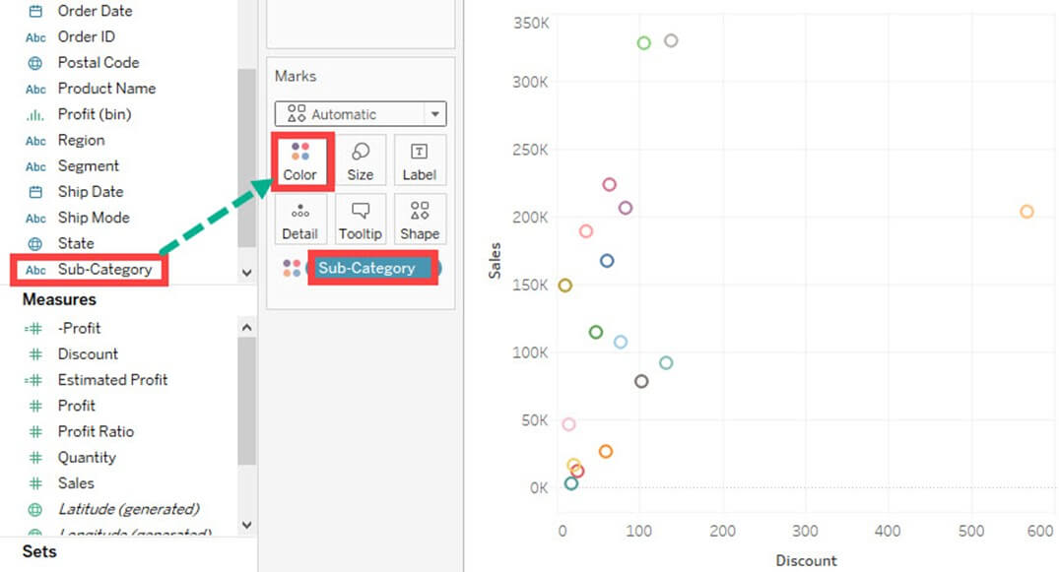
Notes:
This creates a scatter plot by default.
Step 2)
Drag 'Sub-Category' into Color icon present in the Marks card.
It creates a scatter plot showing the relationship between discount and sales for each sub-category.

Slide 31
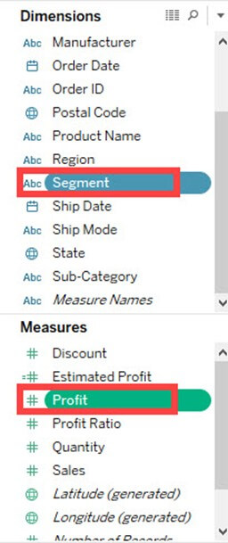
Pie Chart
Notes:
Pie Chart:
A pie chart can show the segment-wise data. It can show the contribution of measure over different members in a dimension. The angle of pie determines the measured value. Different colors can be assigned to pie to represent the members in a dimension.
Step 1) Go to a new Worksheet
Select Segment and Sales from data pane.

Slide 32
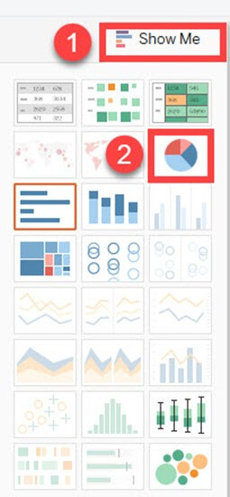
Notes:
Step 2)
Click on 'Show Me' button present in the top right corner of the worksheet.
Select 'Pie Chart' from the list.

Slide 33
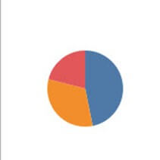
Notes:
It creates a Pie Chart as shown above.

Slide 34
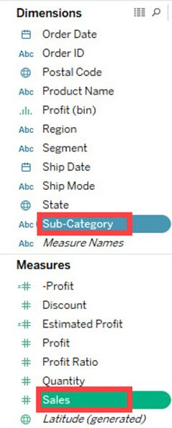
Bubble Chart
Notes:
Bubble Chart:
A bubble chart visualizes the measures and dimensions in the form of bubbles. The sizes of the bubbles determine the size of measure value for effective visualization. The color of bubbles can be set to differentiate the members present in a dimension. The procedure to create bubble chart is given below.
Step 1) Go to a new Worksheet.
Hold on the Control key in the keyboard.
Click on 'Sub-Category' and 'Sales'.

Slide 35
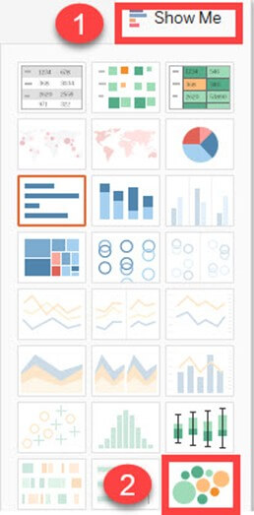
Notes:
Step 2)
Click on the 'Show Me' option present in the top right corner of the worksheet.
Select the 'Packed bubbles' icon as shown in the image.

Slide 36
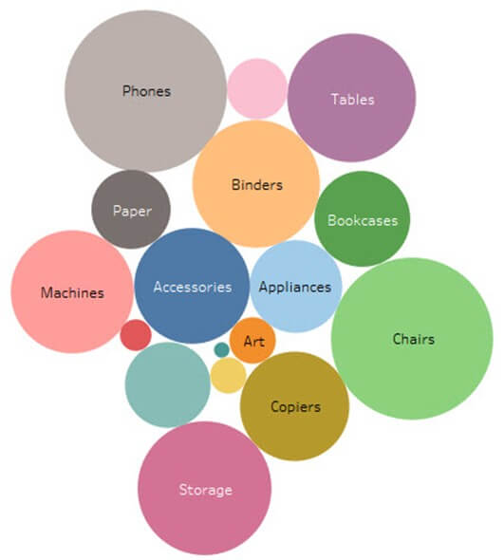
Notes:
It creates a bubble chart as shown above

Slide 37
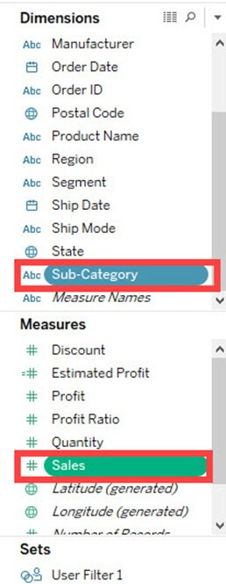
Heat Map
Notes:
Heat Map:
A heat map can visualize the data in the form of size as well as color on different measures. Two different measures can be visualized simultaneously using heat map. One measure can be assigned to size whereas another measure can be assigned to the color of the heat map. The procedure to create heat map is given as follows:
Step 1) Go to a new Worksheet.
Hold the control key in keyboard and select 'Sub-Category' and 'Sales' from the data pane.

Slide 38
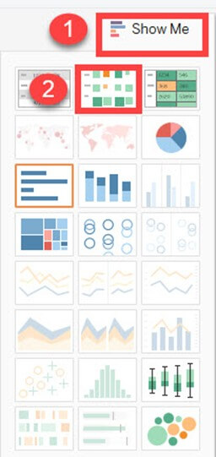
Notes:
Step 2)
Click on the 'Show me' button present in the top right corner of the worksheet.
Select the 'Heat Map' icon as shown in the image.

Slide 39
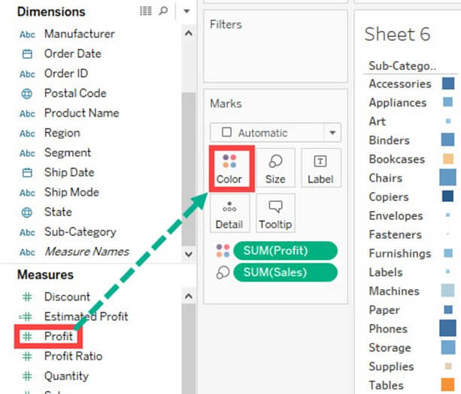
Notes:
Step 3) Drag 'Profit' into the Color box.

Slide 40
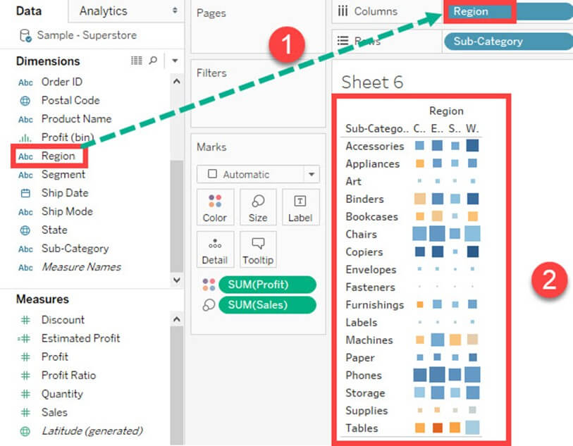
Notes:
Step 4)
Drag 'Region' into Columns.
This will create a Heat map. It can be used to visualize Sales and Profit across different dimension.

Slide 41
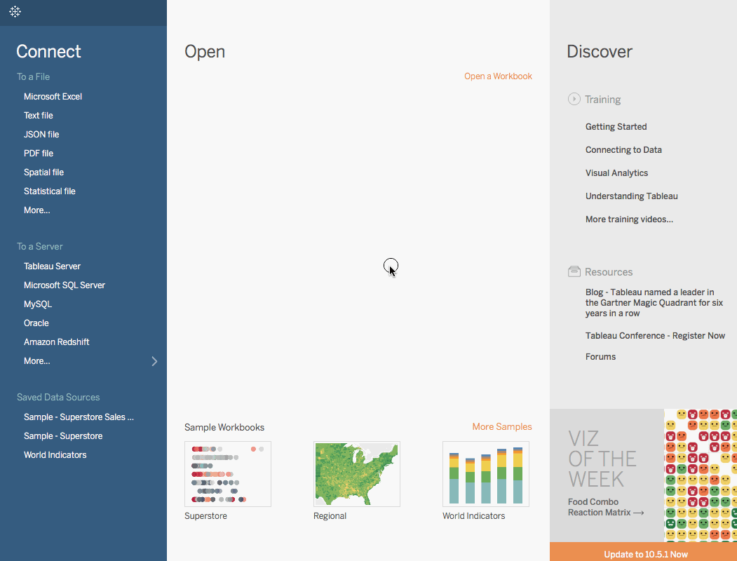
Tree Map

Slide 42
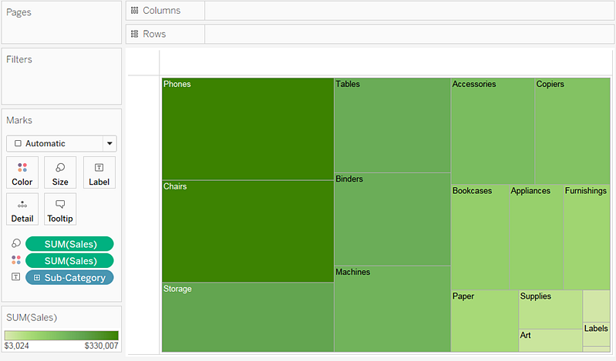

Slide 43


Slide 44


Slide 45

Geographical Map

